Slide 1

Investment thesis: defend the genuine-parts channel before the fleet contracts further
A BlackRock-style macro view of UMI: demand base, capture gap, and execution priorities.
Fleet outlook
Target
-7.4%
€3.05m
working end-2026 estimate
extended FY2027
ISZE / UMI Sales Review Prototype
source: UMI Sales Review FY2027
Notes:
[Sources]
- Source deck: ISZE_UMI_Sales_Review_FY2027_ModeA_only.pptx. UMI review title and meeting context: lines 23-25.
- FY2027 YTD and budget/LY figures: lines 55-65.
- Commercial parts performance: lines 70-80.
- Category movers: lines 85-150.
- GPS, service-parts coverage, IDS and fleet/target data: lines 176-235 and 240-276.
- SPA and Sales-to-Dealer ask: lines 286-345.

Slide 2
The target is not a growth story; it is a capture story
UMI target rises while the vehicle parc is expected to decline.
ISZE / UMI Sales Review Prototype
source: UMI Sales Review FY2027
Notes:
[Sources]
- Source deck: ISZE_UMI_Sales_Review_FY2027_ModeA_only.pptx. UMI review title and meeting context: lines 23-25.
- FY2027 YTD and budget/LY figures: lines 55-65.
- Commercial parts performance: lines 70-80.
- Category movers: lines 85-150.
- GPS, service-parts coverage, IDS and fleet/target data: lines 176-235 and 240-276.
- SPA and Sales-to-Dealer ask: lines 286-345.

Slide 3
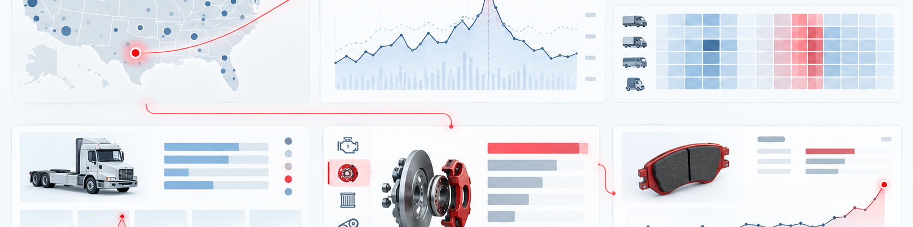
Risk dashboard: four items determine whether the plan is credible
The analysis should become an execution checklist.
Shell price hold
Brake rotor gap
Revenue gap into Aug
12.0% capture
Priority: High
Priority: High
IDS spread
No Std data
30pt dealer range
No PN-level dealer view
Priority: Medium
Priority: High
ISZE / UMI Sales Review Prototype
source: UMI Sales Review FY2027
Notes:
[Sources]
- Source deck: ISZE_UMI_Sales_Review_FY2027_ModeA_only.pptx. UMI review title and meeting context: lines 23-25.
- FY2027 YTD and budget/LY figures: lines 55-65.
- Commercial parts performance: lines 70-80.
- Category movers: lines 85-150.
- GPS, service-parts coverage, IDS and fleet/target data: lines 176-235 and 240-276.
- SPA and Sales-to-Dealer ask: lines 286-345.

Slide 4
Recommended stance: agree a staged plan, not a single number
Give UMI a target and a small set of controllable actions.
Execution priorities
Base case
Target accepted
Close Shell price hold
provided incentive and data logic are aligned
Pick first service-parts pilot
Return SPA counter-list
Upside case
SPA + service pilot
Share Sales-to-Dealer data
captures fast movers and service items
Risk case
Shell unresolved
July pattern continues
ISZE / UMI Sales Review Prototype
source: UMI Sales Review FY2027
Notes:
[Sources]
- Source deck: ISZE_UMI_Sales_Review_FY2027_ModeA_only.pptx. UMI review title and meeting context: lines 23-25.
- FY2027 YTD and budget/LY figures: lines 55-65.
- Commercial parts performance: lines 70-80.
- Category movers: lines 85-150.
- GPS, service-parts coverage, IDS and fleet/target data: lines 176-235 and 240-276.
- SPA and Sales-to-Dealer ask: lines 286-345.

